Slide 1
Clustering & EM Algorithm
Slides adapted from David Kauchak, Sebastian Thrun and Christopher Bishop
TexPoint fonts used in EMF.
Read the TexPoint manual before you delete this box.: 

Slide 2
Unsupervised Learning
Most of our previous methods were supervised methods
Training Data
Supervised learning: Data <x, y>
Unsupervised Learning: Data x

Slide 3
Clustering/Density Estimation
$$$
age
No supervision: only given data and want to find natural groupings

Slide 4
Unsupervised Learning
Clustering is the most common application for unsupervised learning
Clustering: the process of grouping a set of objects into classes of similar objects
Additionally: learning probabilities/parameters for models
Learn a translation dictionary
Learn a grammar for a language
Learn the social graph

Slide 5
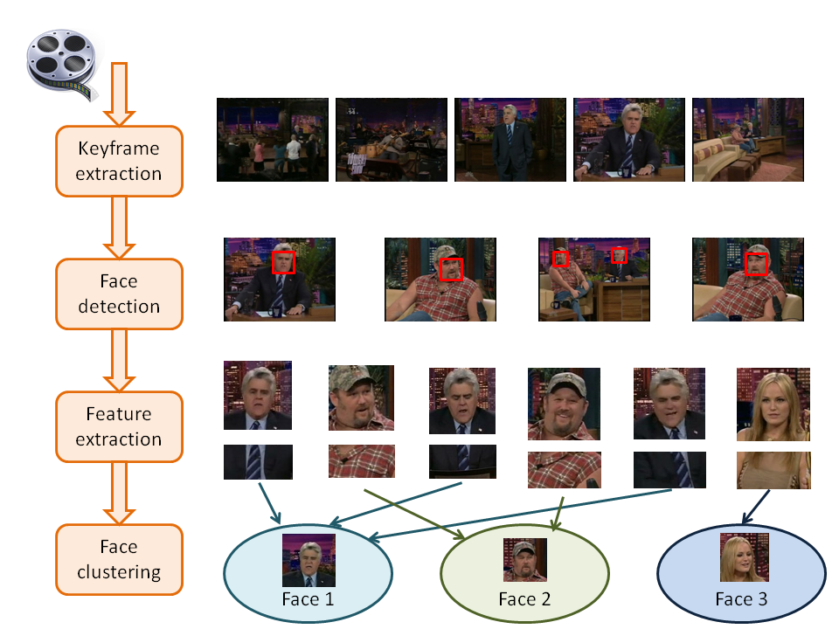
Face Clustering

Slide 6
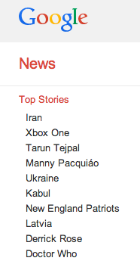
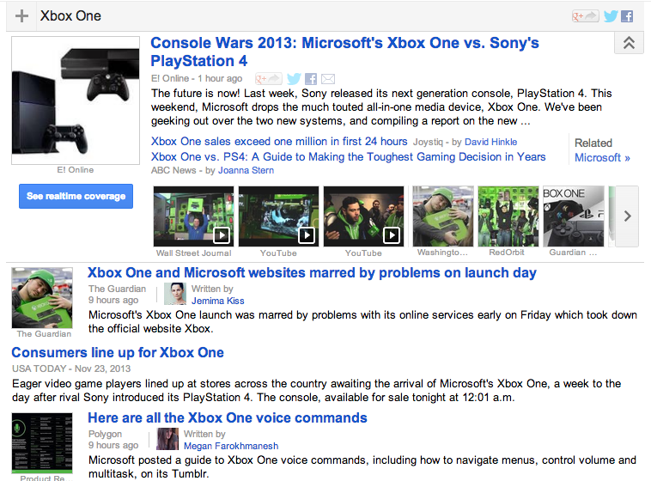
Google News

Slide 7
Clustering in search advertising
Find clusters of advertisers and keywords
Keyword suggestion
Performance estimation
bids
Advertiser
Bidded Keyword
~10M nodes

Slide 8
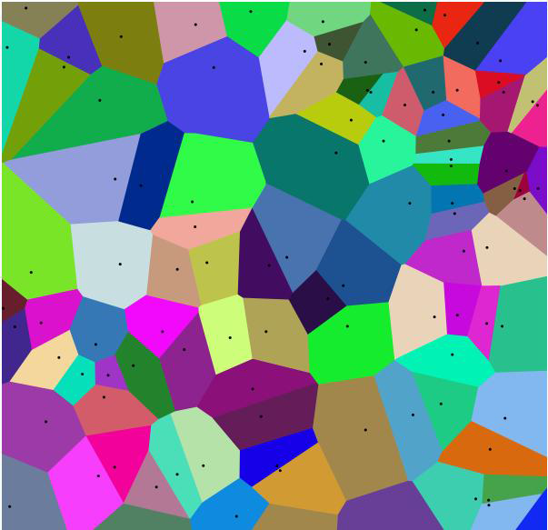
Vector Quantization
Representation of data in terms of codewords
A data point is represented as the index of the nearest codeword
In 2-D you end up storing one number, not two
Image from Wikipedia

Slide 9
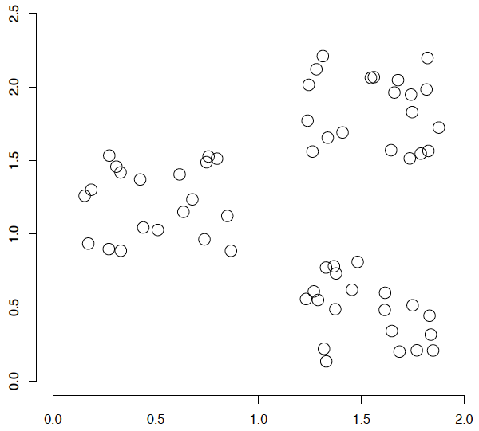
Clustering in Feature Space
What are some of the issues for clustering?

Slide 10
Clustering Issues
Representation for clustering
How do we represent an example
features, etc.
Similarity/distance between examples
Flat clustering or hierarchical
Number of clusters
Fixed a priori
Data driven?

Slide 11
Clustering Algorithms
Flat algorithms
Usually start with a random (partial) partitioning
Refine it iteratively
K means clustering
Model based clustering
Spectral clustering
Hierarchical algorithms
Bottom-up, agglomerative
Top-down, divisive

Slide 12
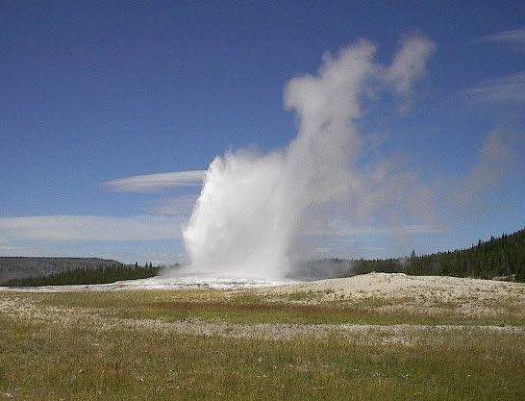
Old Faithful

Slide 13
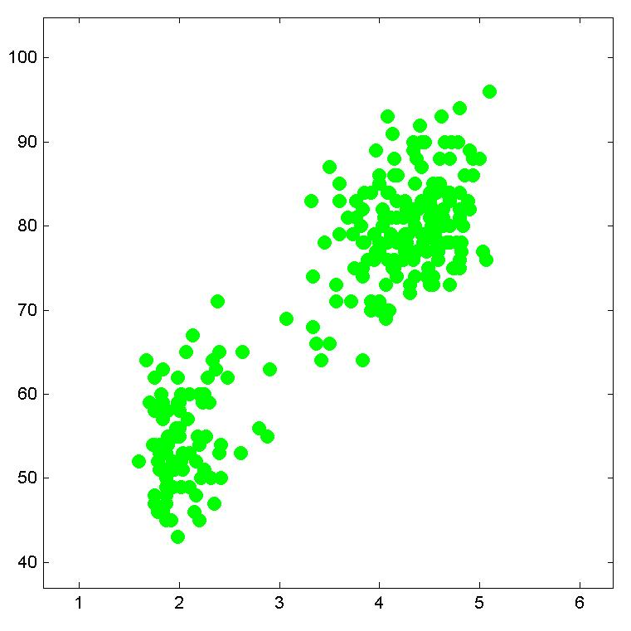
Old Faithful Dataset
Time between eruptions (minutes)
Duration of eruption (minutes)

Slide 14
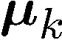
K-means Algorithm
Goal: represent a data set in terms of K clusters each of which is summarized by a prototype
Initialize prototypes, then iterate between two phases:
E-step: assign each data point to nearest prototype
M-step: update prototypes to be the cluster means
Simplest version is based on Euclidean distance
re-scale Old Faithful data

Slide 15
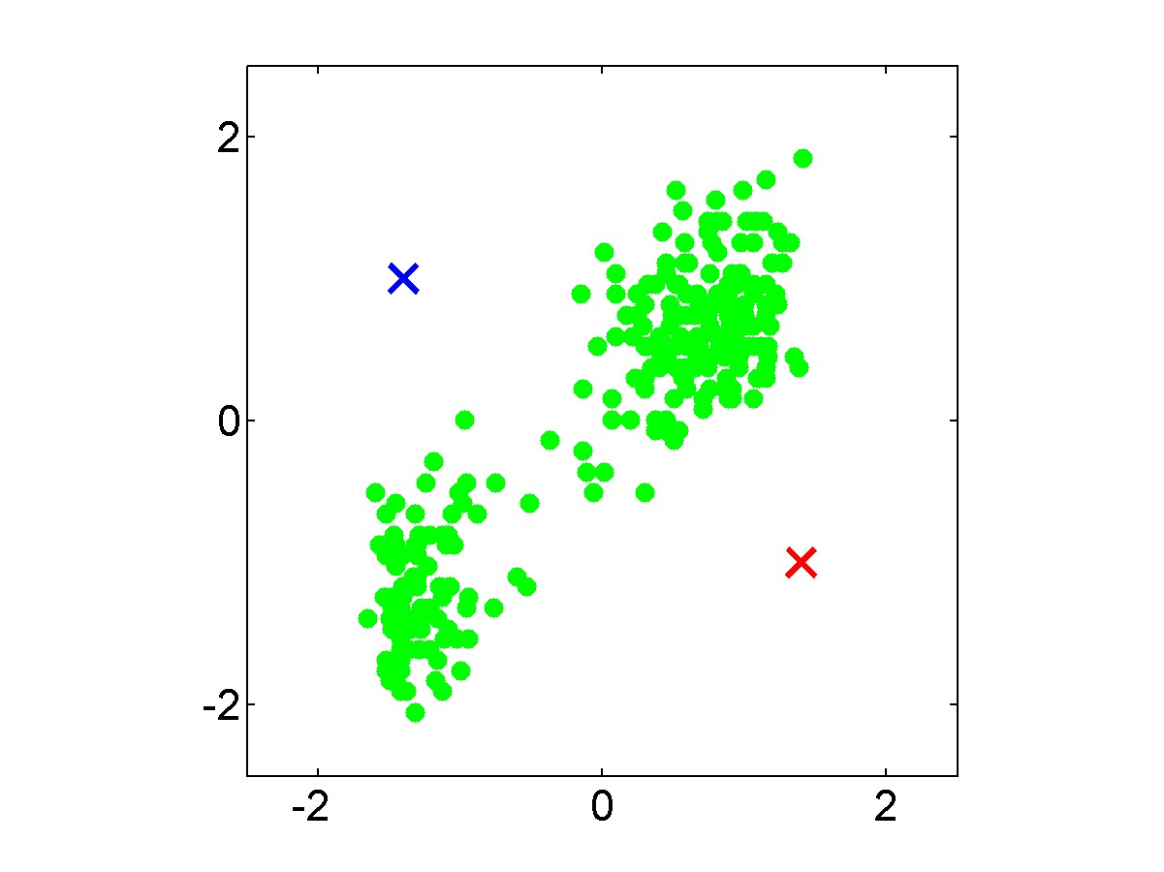

Slide 16
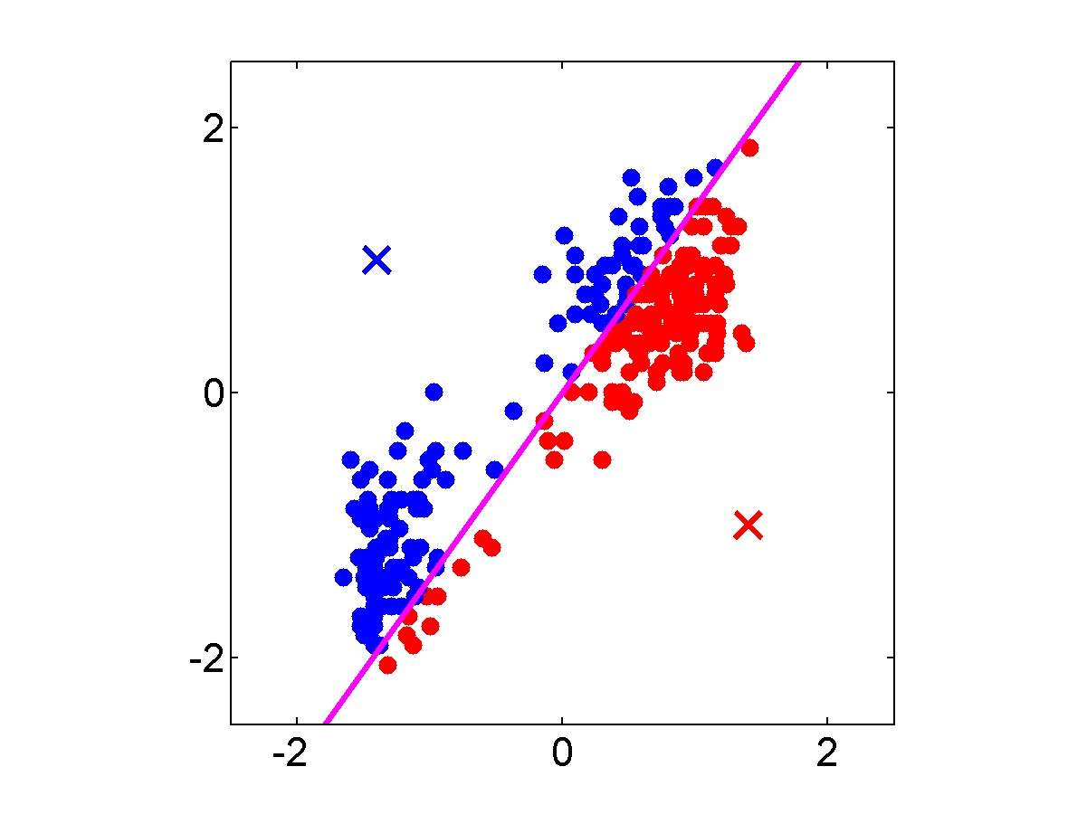

Slide 17
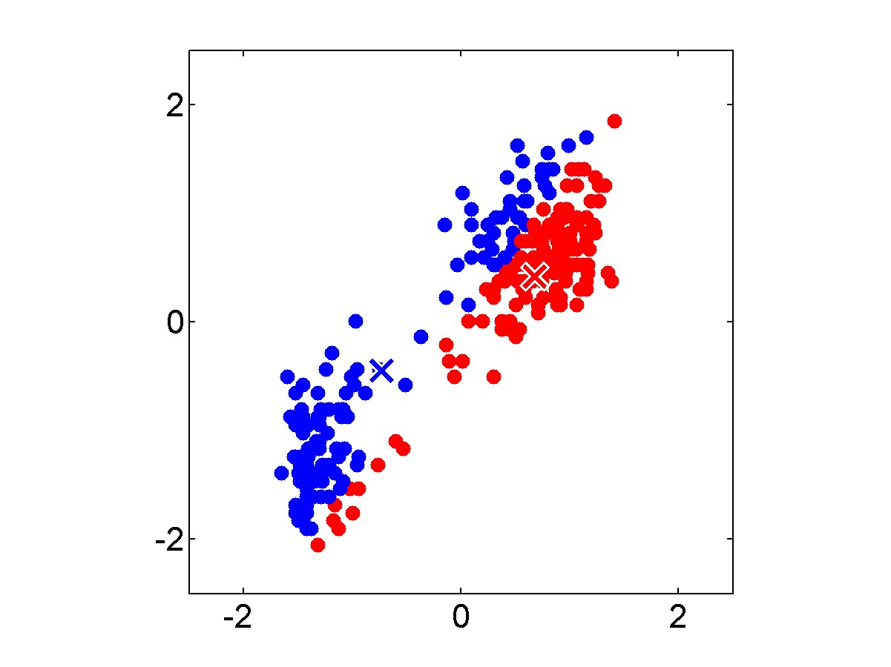

Slide 18
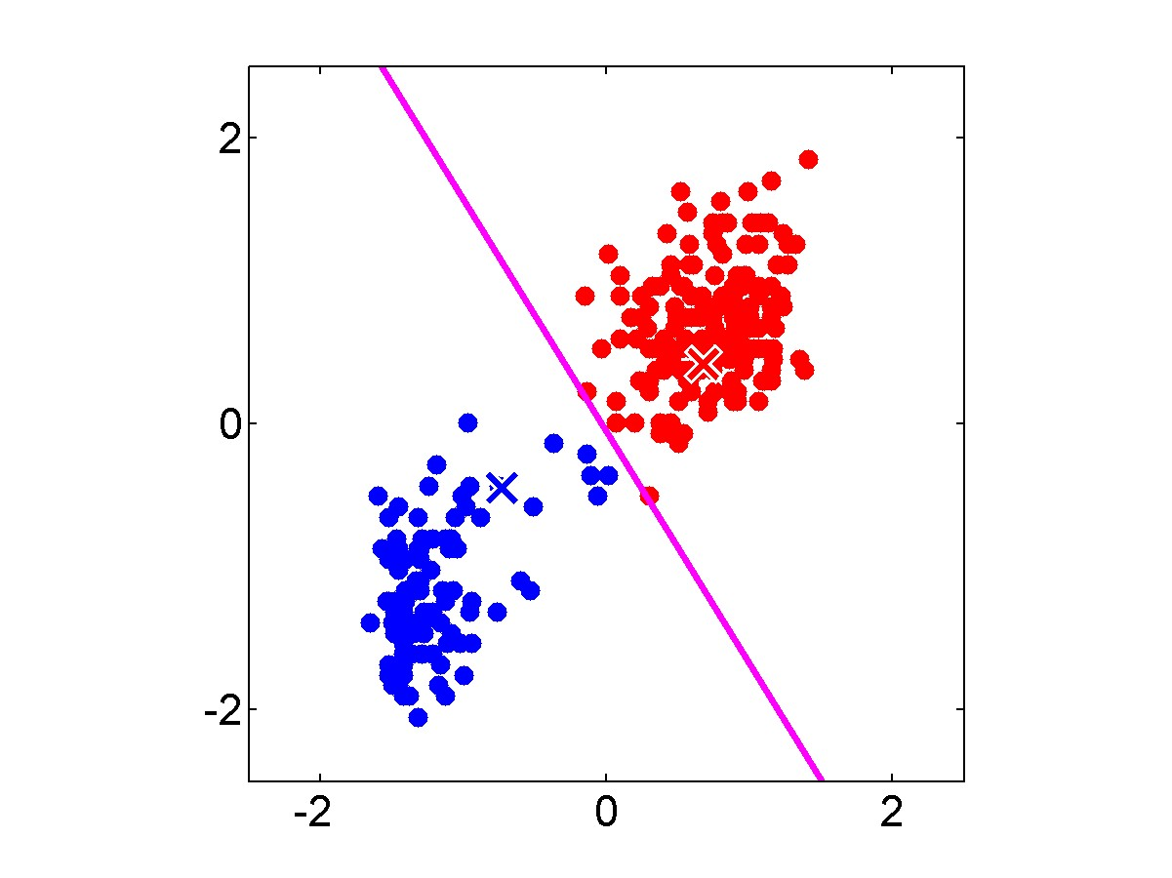

Slide 19


Slide 20
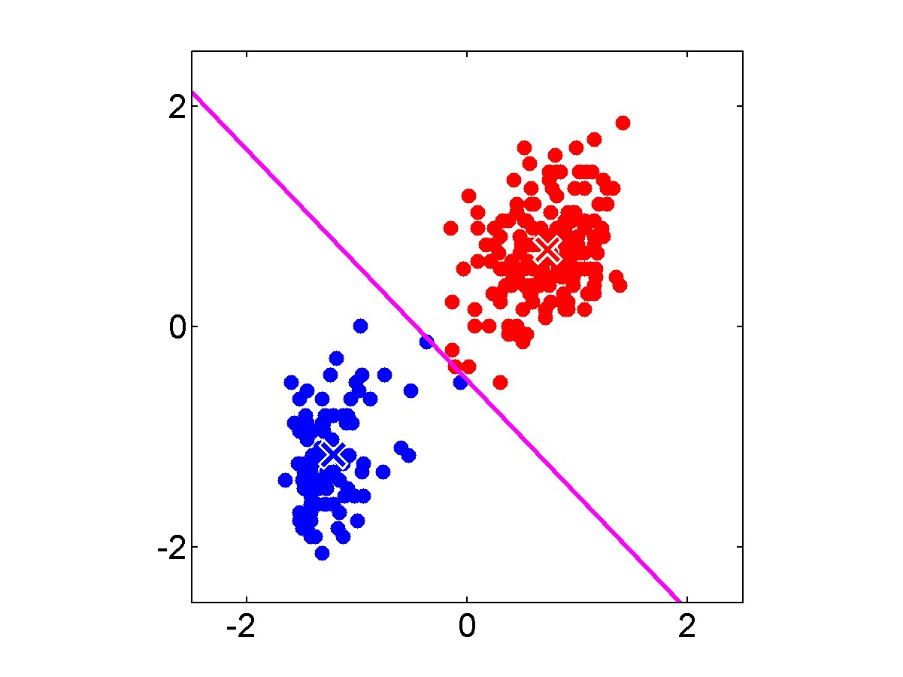

Slide 21


Slide 22


Slide 23


Slide 24
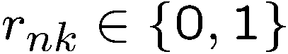
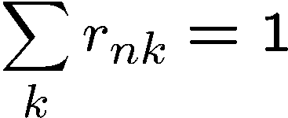
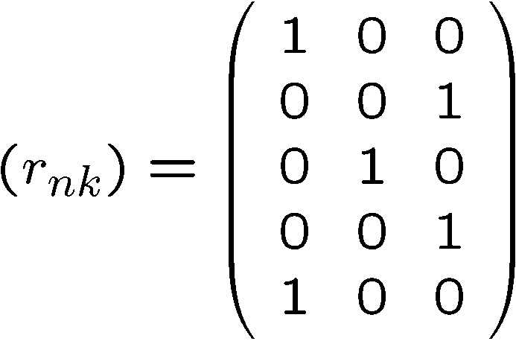
Responsibilities
Responsibilities assign data points to clusters such that
Example: 5 data points and 3 clusters

Slide 25
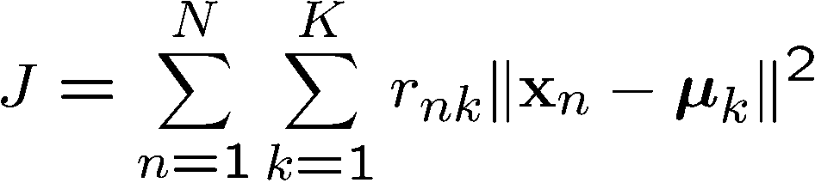
K-means Cost Function
data
responsibilities
prototypes
Is Euclidean distance required?

Slide 26
Euclidean Distance
reasonable for “spatial” data

Slide 27
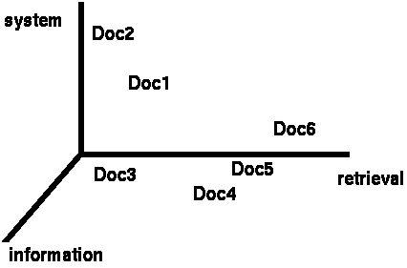
Clustering Documents?
Consider a simple text-based feature
One feature for each word
Value is the number of word occurrences in document
Documents are points or vectors in this space

Slide 28
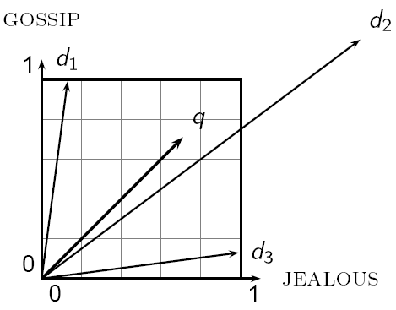
Issues with Euclidean Distance
Which document is closest to q using Euclidian distance?
Which do you think should be closer?

Slide 29
Issues with Euclidean Distance
the Euclidean distance between q and d₂ is large
However, the distribution of terms in the query q and the distribution of terms in the document d₂ are very similar
This is not what we want!

Slide 30
Cosine Similarity
correlated with the angle between two vectors

Slide 31
Cosine Distance
Cosine similarity returns a value between 0 (not similar) and 1 (similar)
We want cosine distance:
Useful for text and many other data sets
Now, back to k-means…

Slide 32
K-means Cost Function
data
responsibilities
prototypes

Slide 33
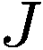
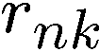
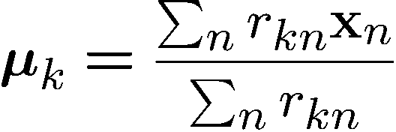
Minimizing the Cost Function
E-step: minimize w.r.t.
assigns each data point to nearest prototype
M-step: minimize w.r.t
gives
each prototype set to the mean of points in that cluster
Convergence guaranteed since there is a finite number of possible settings for the responsibilities

Slide 34
K-Means Convergence
Convergence guaranteed since there is a finite number of possible settings for the responsibilities
Does this mean that k-means will always find the minimum loss assignment?
No! It will find a (local) minimum
k-means loss function is generally not convex
most problems have many local minima
only guaranteed to find one of them
One strategy is to run algorithm several times and keep the best (lowest cost) assignment

Slide 35
K-means Problems
Algorithm (in a nutshell):
Start with some initial cluster centers
Iterate:
Assign/cluster each example to closest center
Recalculate centers as the mean of the points in a cluster
What would happen here?

Slide 36
Seed choice
Results can vary drastically based on random seed selection
Bad seeds can lead to:
poor convergence rate
convergence to sub-optimal assignments
Common heuristics
Random centers in the space
Randomly pick examples
Points least similar to any existing center (e.g., furthest centers heuristic)
Try out multiple starting points
Initialize with the results of another clustering method

Slide 37
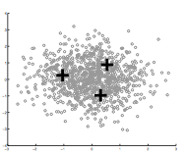
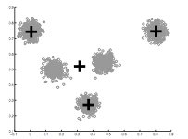
How Many Clusters?
Number of clusters K must be provided
How should we determine the number of clusters?
We’ll cover two options…
too many
too few

Slide 38
Deciding K
Try several values and look for the “elbow” in the graph of objective function value
data
responsibilities
prototypes

Slide 39
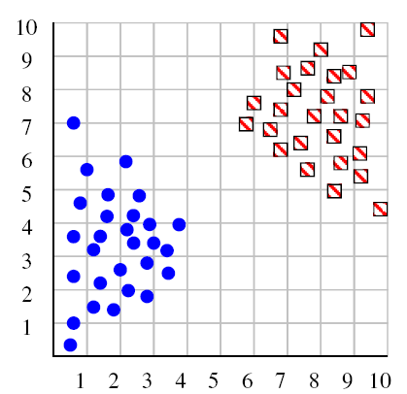
Deciding K
Try a few values for K
Image: Henry Lin

Slide 40
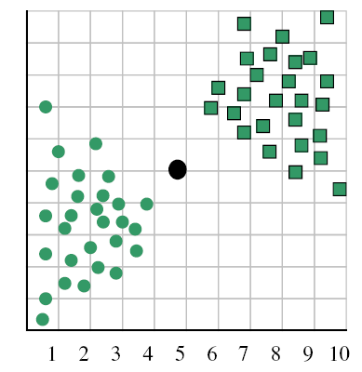
Deciding K
When k = 1, the objective function is 873.0
Image: Henry Lin
Notes:
Objective function is just the sum of the squared distances of points to their assigned clusters.

Slide 41
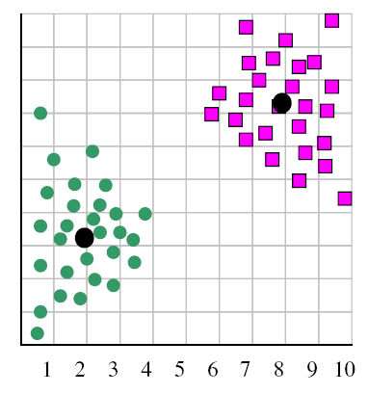
Deciding K
When k = 2, the objective function is 173.1
Image: Henry Lin

Slide 42
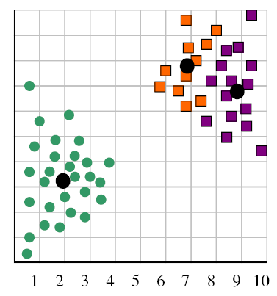
Deciding K
When k = 3, the objective function is 133.6
Image: Henry Lin

Slide 43
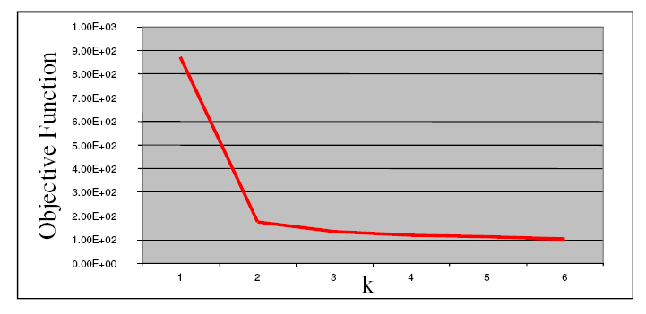
Deciding K
We can plot objective function values for k=1 to 6
The abrupt change at k=2 is highly suggestive of two clusters
“knee finding” or “elbow finding”
Note that the results are not always as clear cut as in this toy example
Image: Henry Lin

Slide 44
Deciding K: Approach #2
k-means loss revisited
K-means is trying to minimize:
What happens when k increases?
Loss goes down! (Hmmm….)
How do we handle decrease in loss with increasing model complexity?
Regularization

Slide 45
Deciding K: Regularization
K-means is trying to minimize:
(where N = number of points)
2 regularization options
What effect will this have? Which will tend to produce smaller k?

Slide 46
Deciding K: Regularization
(where N = number of points)
2 regularization options
AIC penalizes increases in K more harshly
Both require a change to the K-means algorithm
Tend to work reasonably well in practice if you don’t know K

Slide 47
K-Means Time Complexity
Variables: K clusters, n data points, m features/dimensions, I iterations
What is the runtime complexity?
Computing distance between two points is O(m)
Reassigning clusters: O(Kn) distance computations, or O(Knm)
Computing centroids: Each points gets added once to some centroid: O(nm)
Both steps for I iterations: O(Iknm)
In practice, K-means converges quickly and is fairly fast

Slide 48
What Is A Good Clustering Assignment?
A good clustering will produce:
High intra-class (i.e., intra-cluster) similarity
Low inter-class similarity
How should we evaluate clustering?
Common approach: use labeled data
Cluster input data (without labels)
Check to see if clusters reproduce class partitions

Slide 49
Evaluating Clustering
Purity: the proportion of the dominant class in the cluster
• •
• •
• •
• •
• •
• •
• •
•
Cluster I
Cluster II
Cluster III
Cluster I: Purity = 1/4 (max(3, 1, 0)) = 3/4
Cluster II: Purity = 1/6 (max(1, 4, 1)) = 4/6
Overall purity?
Cluster III: Purity = 1/5 (max(2, 0, 3)) = 3/5

Slide 50
Overall purity
Cluster I: Purity = 1/4 (max(3, 1, 0)) = 3/4
Cluster II: Purity = 1/6 (max(1, 4, 1)) = 4/6
Cluster III: Purity = 1/5 (max(2, 0, 3)) = 3/5
Cluster average:
Weighted average:

Slide 51
Purity isn’t perfect
Which is better based on purity?
Which do you think is better?
Ideas?

Slide 52
Entropy
Average entropy of classes in clusters

Slide 53
K-means Remaining Issues
The last two issues are not as obvious
K-Means assumes a spherical distribution
Hard assignments
Small change in data point can switch it to a different cluster
Can both be addressed with Gaussian Mixture Models…

Slide 54
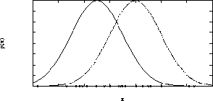
Idea
Data generated from mixture of Gaussians
Latent variables: Correspondence between Data Items and Gaussians

Slide 55
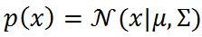
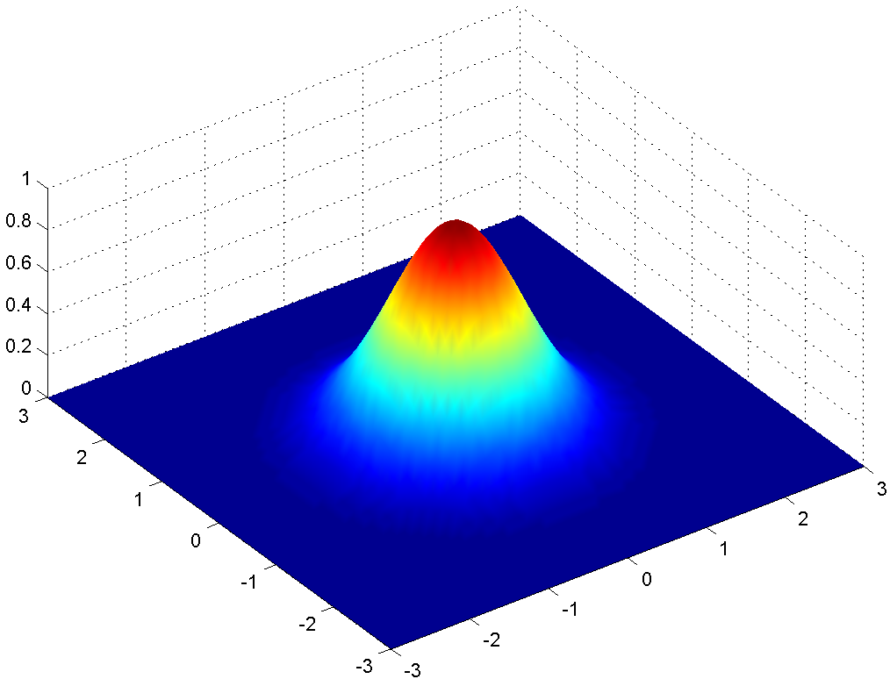
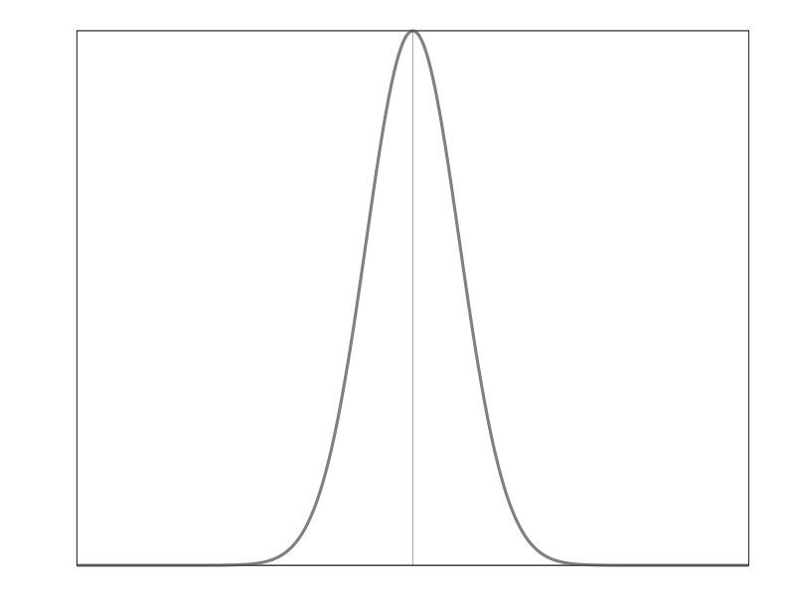
Gaussian Review
Covariance
Mean
1-D
2-D

Slide 56
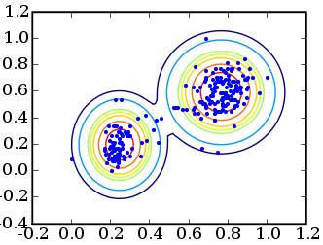
Gaussian Mixture Model

Slide 57
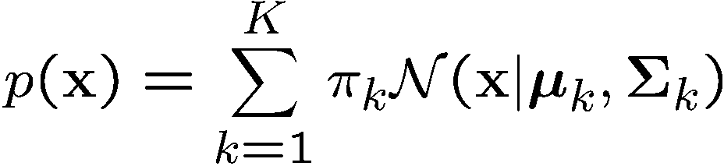
Gaussian Mixtures
Combining Gaussians
Mixing Coefficients
Covariance
Mean

Slide 58
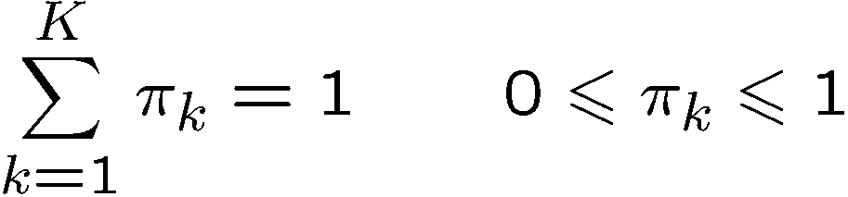
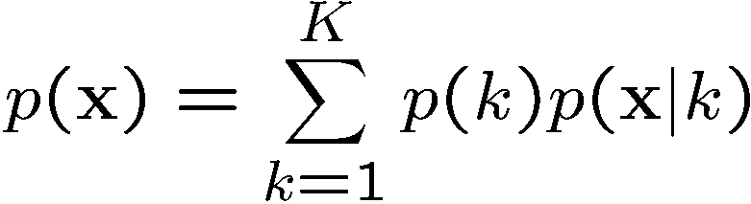
Gaussian Mixtures
Combining Gaussians
Normalization and positivity require
Can interpret the mixing coefficients as prior probabilities
Mixing Coefficients
Covariance
Mean

Slide 59
Example: Mixture of 3 Gaussians

Slide 60
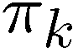
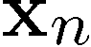
Sampling from the Gaussian
To generate a data point:
first pick one of the components with probability
then draw a sample from that component
Repeat these two steps for each new data point

Slide 61
Synthetic Data Set

Slide 62
Synthetic Data Set Without Labels
We wish to invert this process – given the data set, find the corresponding parameters:
mixing coefficients
means
covariances

Slide 63
Fitting the Gaussian Mixture
If we knew the labels (which component generated each data point), how do we compute the GMM parameters?
Easy. Just compute them
Mixing coefficients: Proportion of each label
Means: Means of each label
Covariances: Covariances of each label
Of course, the problem is that these examples are not labelled

Slide 64
Fitting the Gaussian Mixture (cont’d)
What if instead we knew the GMM parameters? What could we compute?
We could compute the probability that a given point came from a particular distribution
Responsibilities (soft assignment)
Posterior probabilities

Slide 65

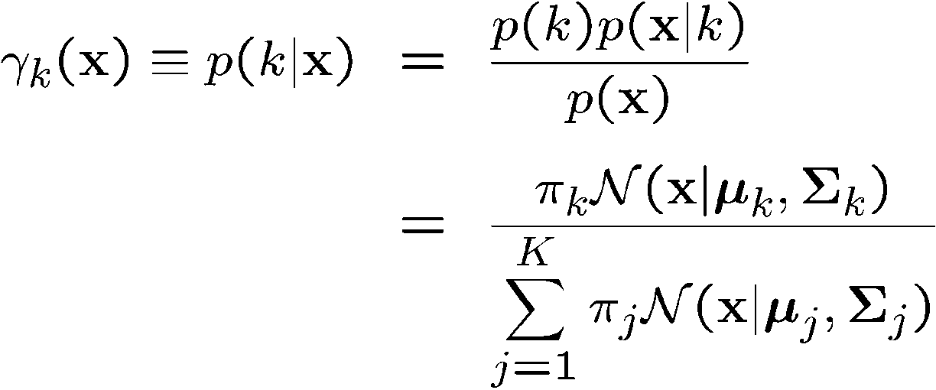
Posterior Probabilities
We can think of the mixing coefficients as prior probabilities for the components
For a given value of we can evaluate the corresponding posterior probabilities, called responsibilities
These are given from Bayes’ theorem by

Slide 66
Posterior Probabilities (color coded)

Slide 67
The EM Algorithm
Expectation-Maximization
Method frequently referenced throughout field of statistics
Term coined in 1977 paper by Arthur Dempster, Nan Laird, and Donald Rubin
Great for problems such as:
If only I knew the value of certain variables, I could compute the right ML hypothesis
If only I knew the right ML hypothesis, I could immediately compute a probability distribution for those variables
Chicken-and-egg problems
Used when some features are not observable
We call these features latent variables

Slide 68
EM Algorithm
The solutions are not closed form since they are coupled
Suggests an iterative scheme for solving them:
Make initial guesses for the parameters
Alternate between the following two stages:
E-step: evaluate responsibilities
M-step: update parameters using ML results

Slide 69
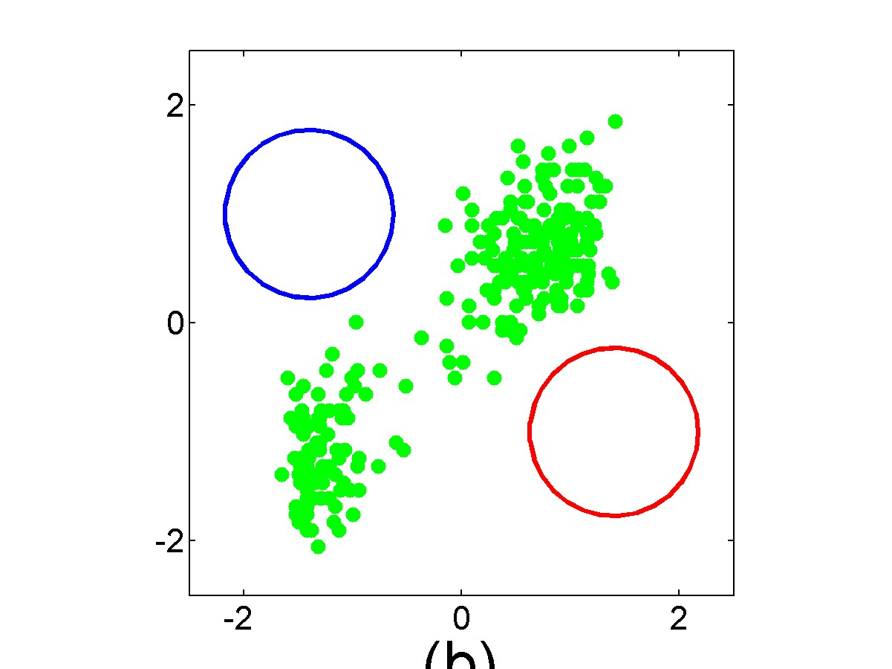

Slide 70
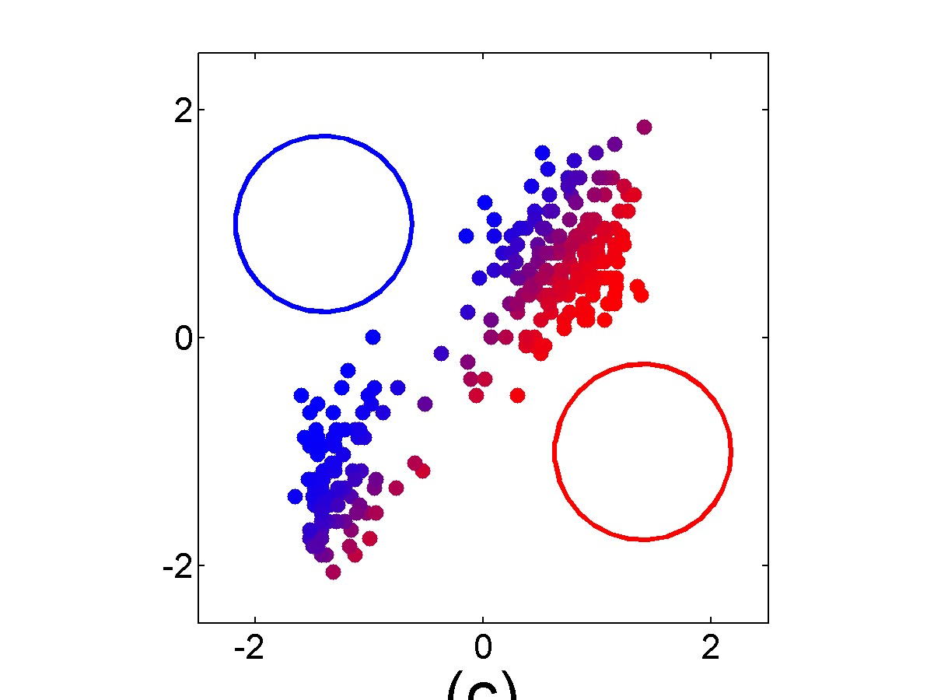

Slide 71
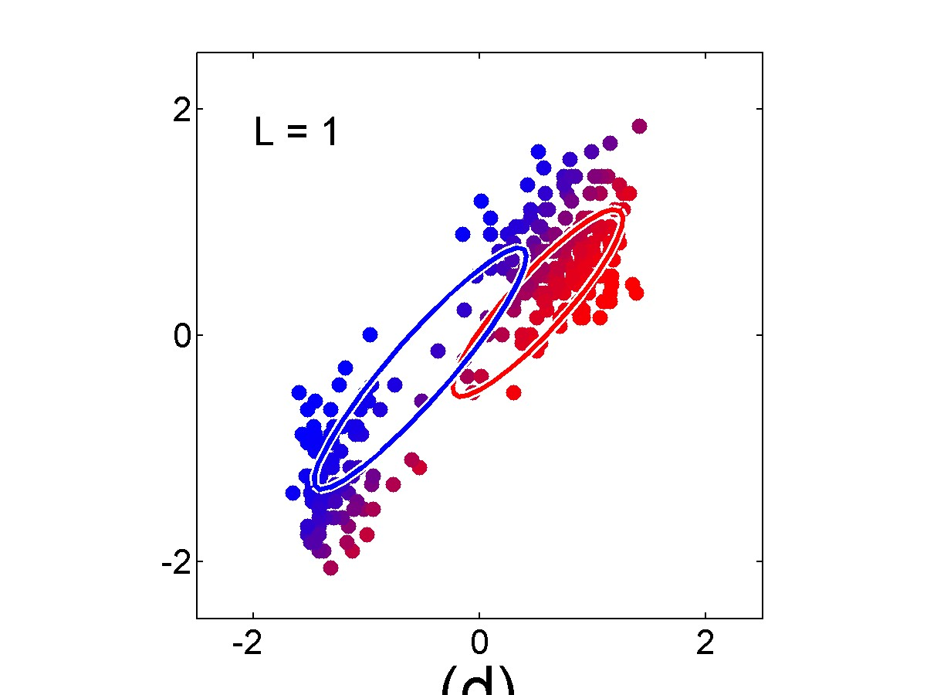

Slide 72
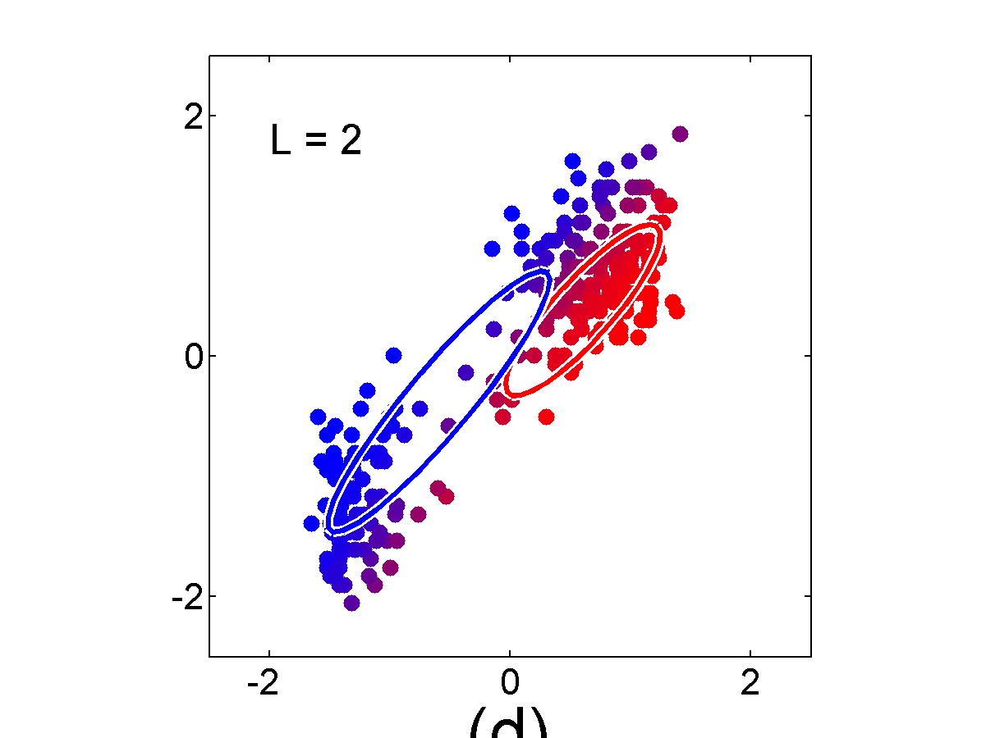

Slide 73
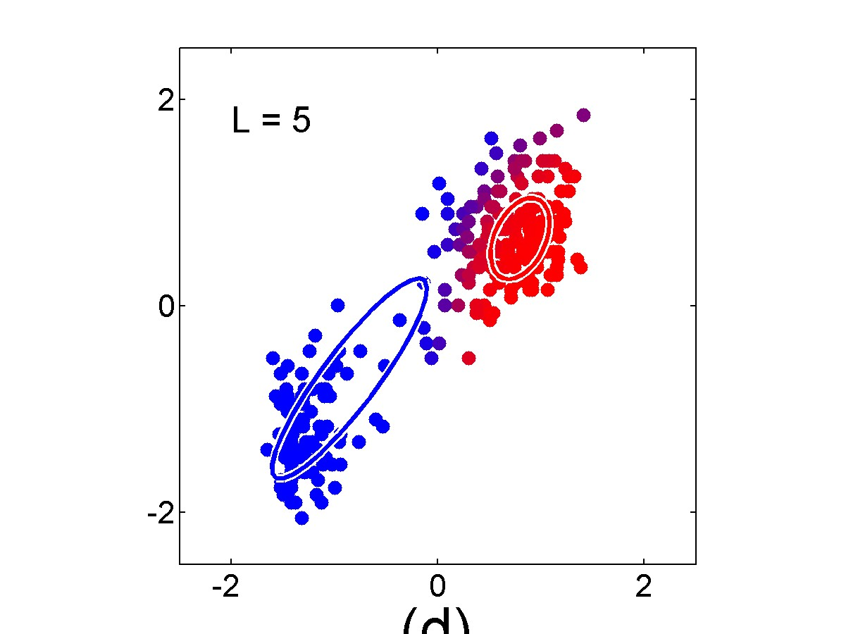

Slide 74
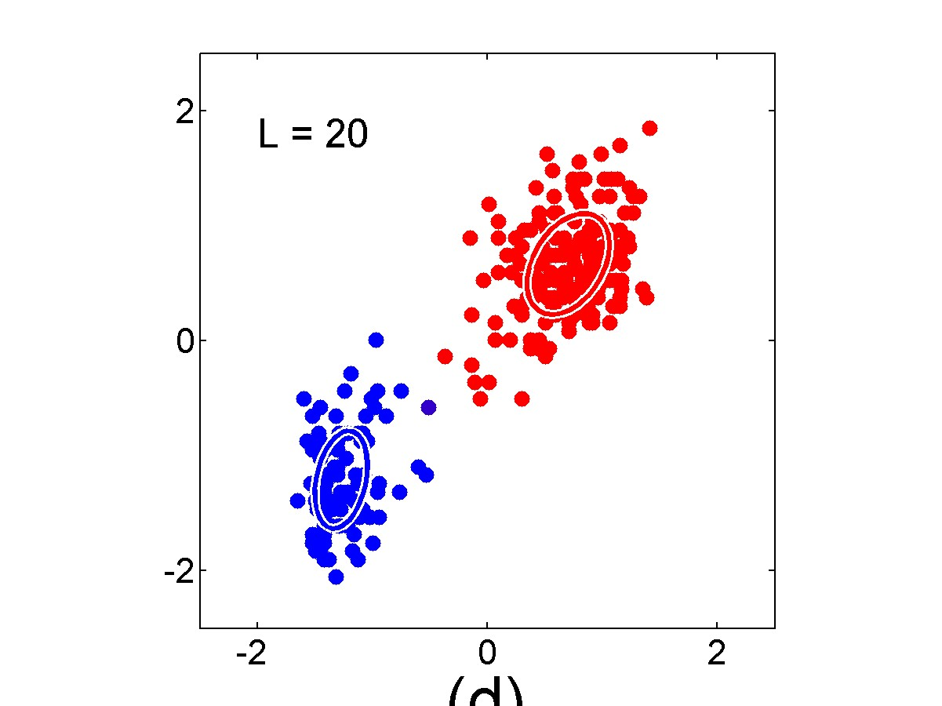

Slide 75
Gaussian Mixture Model vs. K-means
More complex model can better capture the shape of clusters
GMM allows for soft clustering
GMM typically converges more slowly than K-means
GMM initialization often done with K-means

Slide 76
EM Algorithm
EM is a general purpose approach for training a model when you don’t have labels
Not just for clustering!
One of the most general-purpose unsupervised approaches
Training HMMs (Baum-Welch algorithm)
Learning probabilities for Bayesian networks
Learning word alignments for language translation
Learning Twitter friend network
Genetics
Finance

Slide 77
Other clustering algorithms
K-means and EM are the very popular clustering algorithms…
However, they can’t handle all clustering tasks
E.g., non-Gaussian data

Slide 78
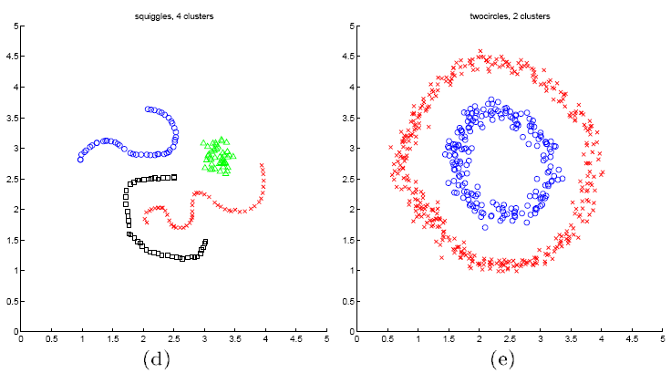
Spectral Clustering Examples
Ng et al On Spectral clustering: analysis and algorithm

